Slide 1

Efficient cloud storage, using Bin Packing algorithms
Amit Molek 318298262
Aviv Mahulya 311289128
Supervisors: Mrs Elena Kramer
Dr. Dan Lamberg

Slide 2

Introduction
What is our project about?
Increasing size of cloud data centers
Bin packing
Online algorithms
Which algorithms?

Slide 3

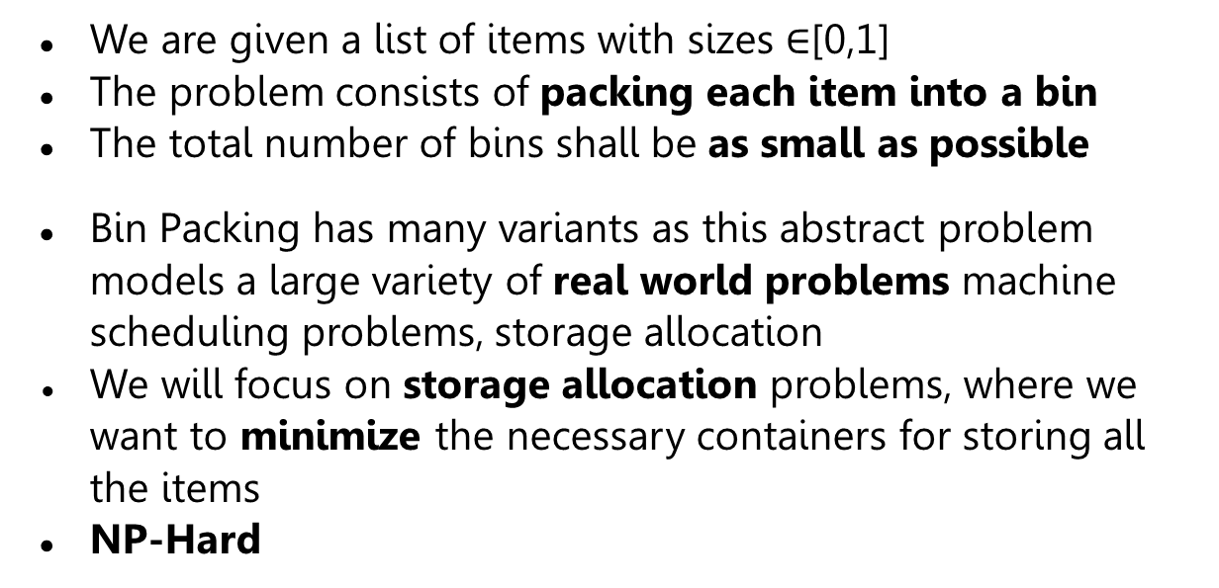
The Bin Packing Problem
We are given a list of items with sizes $∈$[0,1]
The problem consists of packing each item into a bin
The total number of bins shall be as small as possible
Bin Packing has many variants as this abstract problem models a large variety of real world problems machine scheduling problems, storage allocation
We will focus on storage allocation problems, where we want to minimize the necessary containers for storing all the items
NP-Hard

Slide 4
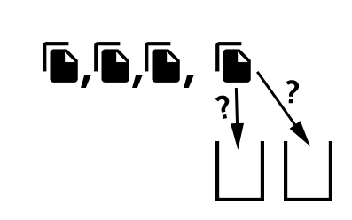
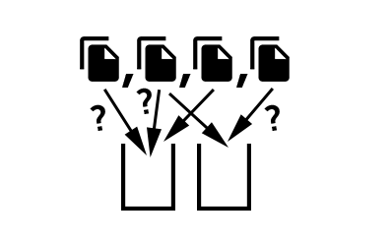
Bin Packing Algorithms
Many of the algorithms depend on the way the input is read
In Online algorithms, the input is read one item at a time
In Offline algorithms, all the items are known from advance
We will focus on Online algorithms
Offline
Online

Slide 5

Bin Packing Algorithms Online Algorithms
A Bin Packing algorithm is called online if it is given the items from L one at a time
No information about the upcoming items
A new item is packed according to the packing and sizes of items that have already arrived before
Work in real-time environments where packing must be immediate or at least very fast

Slide 6
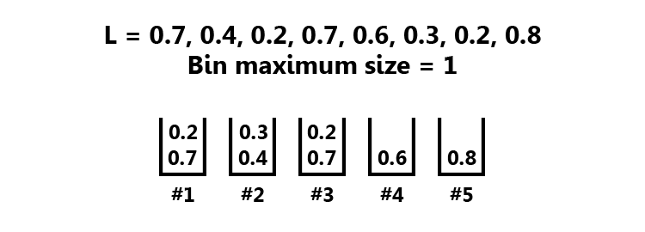
Bin Packing Algorithms The Algorithms – First Fit
The item is packed into the first bin where it fits

Slide 7
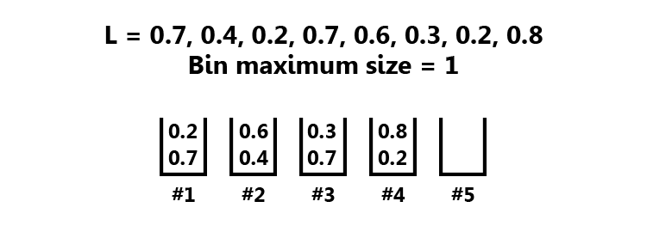
Bin Packing Algorithms The Algorithms – Best Fit
The item is packed into a bin with smallest bin that is big enough

Slide 8
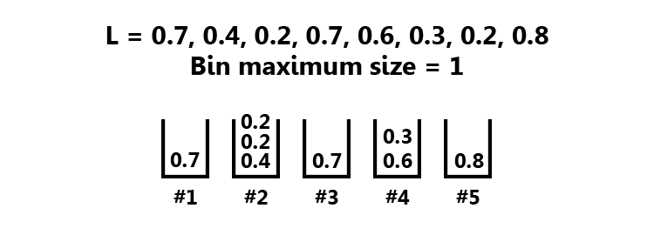
Bin Packing Algorithms The Algorithms – Worst Fit
The item is packed into the bin with the largest possible free space that the item can be stored on

Slide 9
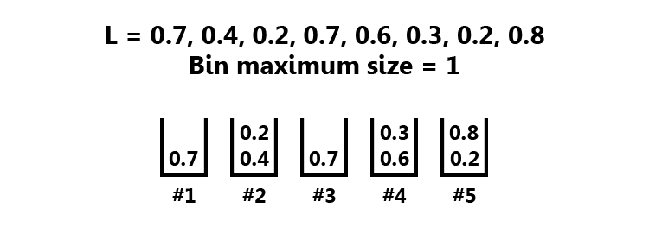
Bin Packing Algorithms The Algorithms – Next Fit
Only one open bin at any time
If the next item cannot be packed into the open bin, the bin gets closed and the item is packed into a new bin

Slide 10
Bin Packing Algorithms-cont.
The generalization of First-Fit, Best-Fit and Worst-Fit algorithms is called Any-Fit algorithms.
These algorithms allow to pack the new item into any open bin where it fits
The item is packed into a new bin if and only if there is no bin where it can be packed

Slide 11

Evaluating Performance Competitive Ratio
Online algorithms are evaluated using the competitive ratio
The idea is to compare the algorithm to an optimal offline algorithm
An online algorithm is r-competitive if
Must perform well on all inputs
Strong Worst-Case performance measure
= Number of bins opened

Slide 12
Evaluating Performance Competitive Ratio
Most of the time Worst-Case performance evaluation, measures extreme cases
Does not represent the performance of the algorithm for an average input

Slide 13
Evaluating Performance Our Approach
Average-Case more suitable for evaluating an online algorithm performance for cloud storage systems.
Exist ? No
Desired measure ? Approximation of how many bins an online algorithm is expected to open for a given input
Compare and chose the optimal algorithm

Slide 14


Evaluating Performance Our Approach - Definition
We define as the expected value of the count of open bins
It will give us a good approximation of what algorithm will open fewer bins for the given input
Exactly our desirable measure for Average-Case
Compared to the competitive ratio, it’s tough to calculate

Slide 15

Evaluating Performance Our Approach - X Definition
We assume the item’s size distribute uniformly in
M = Maximum size each bin can hold
=Probability that the first bin will store exactly items n = Input length | m = Size of the first bin
Different formula for each algorithm

Slide 16



Evaluating Performance X - First Fit

Slide 17


Evaluating Performance X - Next Fit

Slide 18





Evaluating Performance Our Approach - Y Definition
Before we need to know how many bins will be open
Using X we can calculate:
= Probability exactly bins will open

Slide 19


Evaluating Performance Our Approach - Finalizing
Finally, we can define as:
is precisely our desirable Average-Case performance measurement for online algorithms
$${\overline{E}}_{A}\left(50\right)=25$$
For 50 items algorithm A is expected to open 25 bins

Slide 20
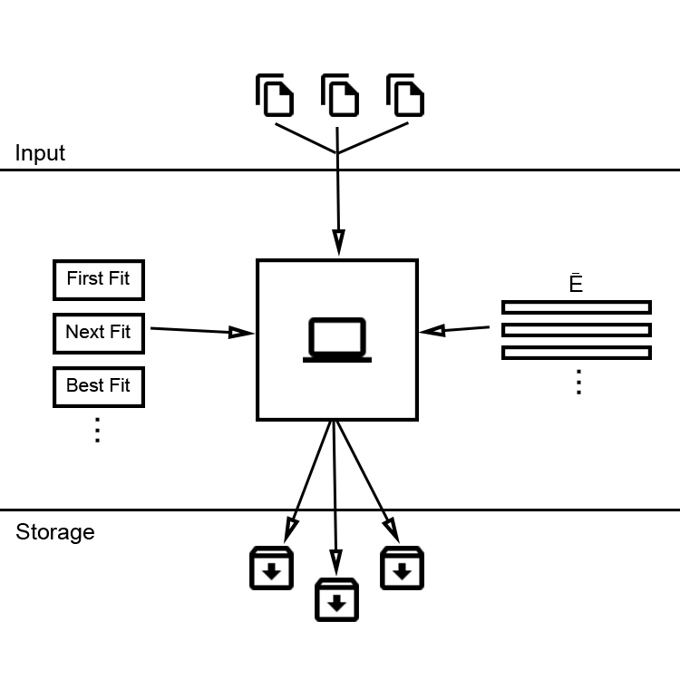
System Design Overview
The system is constructed by a client and a cloud hosted server
The client can upload files to the server
The server will try to store the files with fewer disks (Bins)

Slide 21
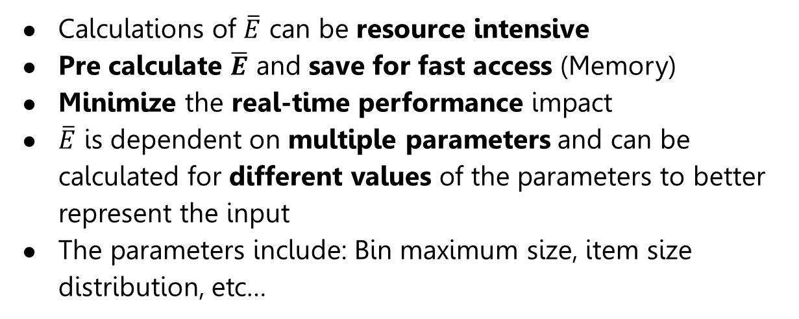
System Design Pre Calculations
Calculations of $\overline{E}$ can be resource intensive
Pre calculate $\overline{E}$ and save for fast access (Memory)
Minimize the real-time performance impact
$\overline{E}$ is dependent on multiple parameters and can be calculated for different values of the parameters to better represent the input
The parameters include: Bin maximum size, item size distribution, etc…

Slide 22
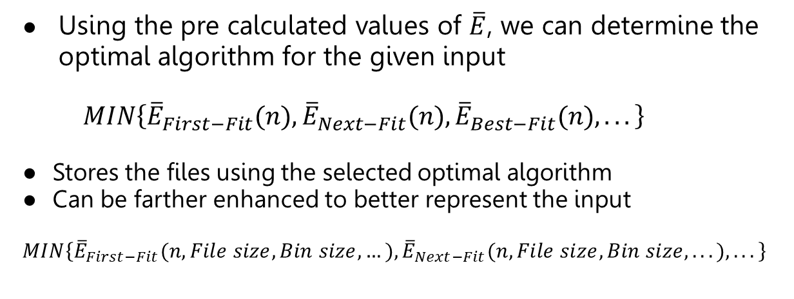
System Design The Algorithm
Using the pre calculated values of $\overline{E}$, we can determine the optimal algorithm for the given input
$$MIN\left\{{\overline{E}}_{First−Fit}(n),{\overline{E}}_{Next−Fit}(n), {\overline{E}}_{Best−Fit}(n), ...\right\}$$
Stores the files using the selected optimal algorithm
Can be farther enhanced to better represent the input
$$MIN\left\{{\overline{E}}_{First−Fit}(n,File size,Bin size,…),{\overline{E}}_{Next−Fit}(n, File size, Bin size,...),...\right\}$$

Slide 23
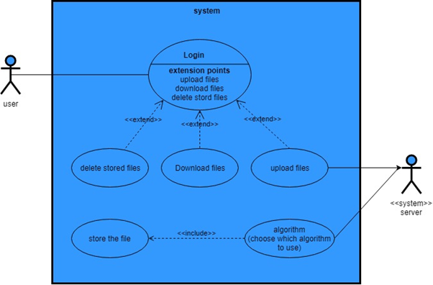
Use Case diagram

Slide 24
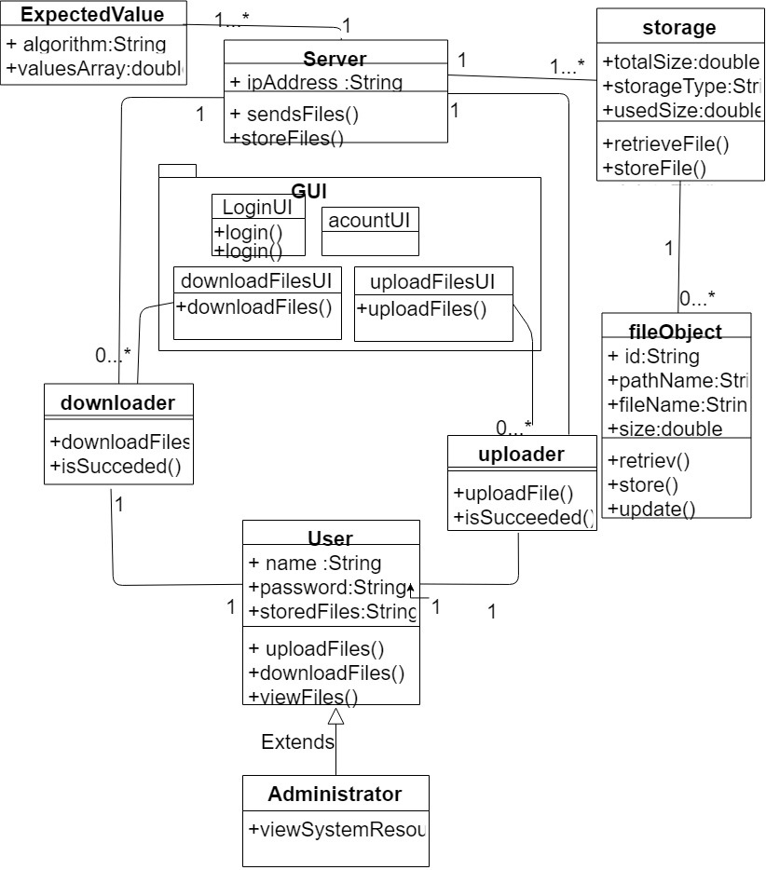
Class Diagram

Slide 25
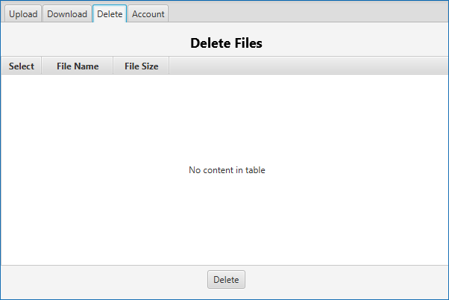
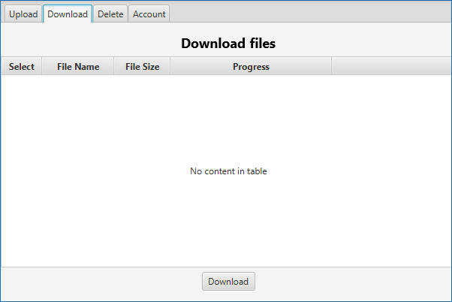
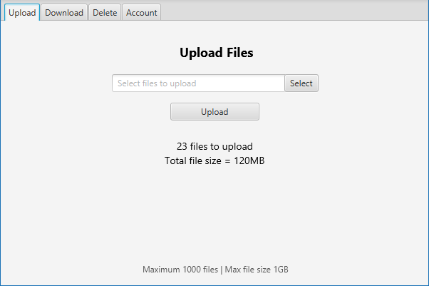
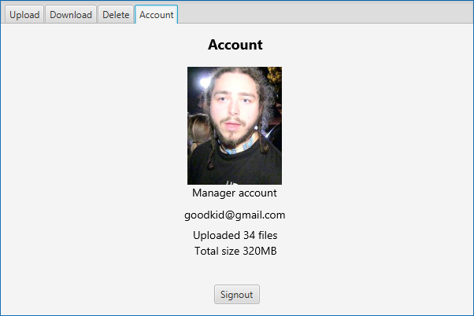
GUI

Slide 26
Test No. | Test subject | Expected result
1. | login with correct details | files manager screen will be displayed
2. | login with incorrect details | error message appear
3. | choose 1 file and press “upload” | “file uploaded successfully” prompt
4. | press “upload” without choosing file | error message appear
5. | Try to upload too big file | error message appear
6. | see the stored files (press “see my files”) | list with the stored files will be displayed
7. | download stored file | file will be downloaded to computer

Slide 27
Test No. | Test subject | Expected result
8. | go back to upload files window(on my files press “back“) | the default page (Upload files)screen will be displayed.
9. | choose many files and press “upload” | “N file uploaded successfully” prompt(N is the number of files)
10. | account sign out | client signs out the account and return to login page
11. | select N files to upload with total size of M | number of file indicator will show “N files to upload”, total size indicator will show “Total files size = M”
12. | select 0 files to delete, and press “delete” button | error message appear

